Slide 1
MANTIS
Minimalist Alert Network for Threat Intelligence System
Final Dissertation Presentation
Final Dissertation | CSY4022
Anuskar Sigdel | 24812606
Supervisor: Nischal Khadka | University of Northampton | August 2026
Notes:
[Sources]
- MANTIS_Final_Dissertation_FINAL.docx, cover page and Chapter 1

Slide 2
1. The Problem MANTIS Addresses
Transparent intrusion detection for constrained Linux hosts
• Small networks still face scans, floods, malicious payloads and known-bad sources.
• Enterprise IDS platforms can require heavyweight packages, extensive rule management and several supporting services.
• Opaque detection paths make results difficult to explain, reproduce and audit in a student research setting.
• MANTIS responds with a dependency-free Python prototype whose capture, detection, evidence and optional response paths remain inspectable.
2
Notes:
[Sources]
- MANTIS_Final_Dissertation_FINAL.docx, Sections 1.1, 1.2 and 2.8.1

Slide 3
2. Aim and Measurable Objectives
One research aim supported by six verifiable objectives
• Aim: design, implement and evaluate a lightweight host-based NIDS using only the Python standard library.
• Capture live Ethernet frames and support reproducible offline PCAP replay.
• Implement five transparent engines for flood, scan, malicious payload, novelty and reputation detection.
• Train from labelled data, persist compatible state and expose CLI, dashboard, SIEM and forensic evidence.
• Evaluate the integrated system while keeping active defence explicitly controlled by policy.
3
Notes:
[Sources]
- MANTIS_Final_Dissertation_FINAL.docx, Section 1.3 and Table 1.1

Slide 4
3. Literature Review and Design Gap
The evidence shaped both the architecture and the evaluation
• Recent studies show strong IDS results, but also warn about leakage, unrealistic base rates and weak transfer across datasets.
  • CIC-IoT2023 provides large-scale attack data, yet its flow features do not directly match raw-packet engine inputs.
• Comparable systems are mature, but none combines dependency freedom, readable detection mathematics and SIEM interoperability at small-host scale.
  • Design implication: keep every detection rule inspectable and report implementation evidence separately from field-accuracy claims.
4
Notes:
[Sources]
- MANTIS_Final_Dissertation_FINAL.docx, Chapter 2 literature review and comparable-system synthesis

Slide 5
4. Comparable Systems
MANTIS occupies a narrow research and teaching niche
System | Strength | Cost for a small host
Snort 3.x | Mature signature engine | Rule-pack management and tuning
Suricata 7.x | Multithreaded throughput | Large configuration surface
Zeek 8.x | Rich protocol analysis | Scripting and deployment learning curve
Wazuh 4.x | Full SIEM platform | Multiple components and infrastructure
MANTIS | Transparent five-engine prototype | Prototype scope and HTTP-only payload visibility
• The contribution is inspectability and low dependency, not feature parity with enterprise platforms.
5
Notes:
[Sources]
- MANTIS_Final_Dissertation_FINAL.docx, Section 2.2 and Table 2.5

Slide 6
5. Methodology
Constructive research: build, evaluate, critique and refine the artefact
• Constructive research defined the problem, built MANTIS, evaluated it and critiqued its limitations.
• Agile and Scrum principles supported short cycles, a prioritised backlog, review and adaptation.
• Kanban made progress visible across requirements, design, construction, testing and documentation.
• V-model traceability linked requirements to unit, integration, system and evaluation evidence.
• Safety controls used offline datasets, loopback services, privacy redaction and policy-gated response.
6
Notes:
[Sources]
- MANTIS_Final_Dissertation_FINAL.docx, Sections 1.4 and 2.3 to 2.7

Slide 7
6. Requirements and Scope
Implemented behaviours are traceable to components and tests
• Capture, parse and replay Ethernet, VLAN, IPv4, TCP, UDP and ICMP traffic.
• Run five detection engines, aggregate verdicts, dispatch alerts and export evidence.
• Train from labelled data and persist compatible engine state in portable JSON.
• Publish dashboard and SIEM data, with optional iptables response disabled unless policy enables it.
• Non-functional priorities are transparency, portability, privacy redaction, bounded storage and safe defaults.
7
Notes:
[Sources]
- MANTIS_Final_Dissertation_FINAL.docx, Section 2.8 and Table 2.6

Slide 8
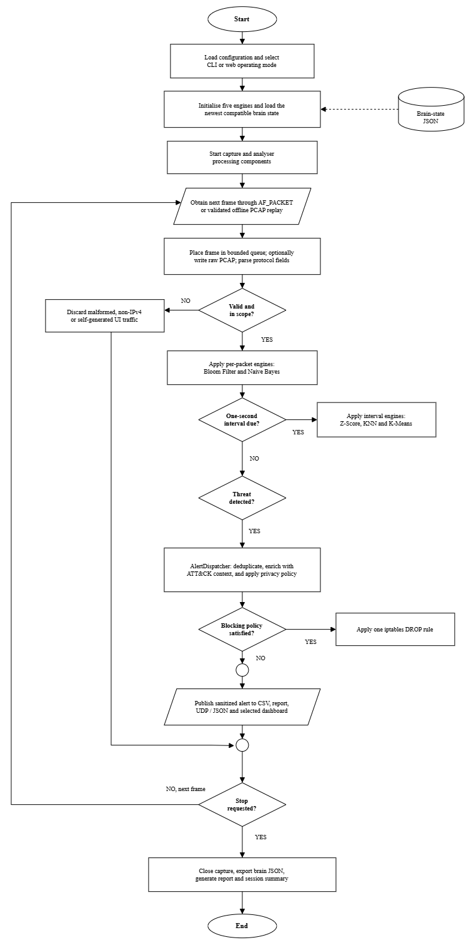
7. MANTIS End-to-End Workflow
Figure 2.8 links training, capture, detection, evidence and response
• Labelled data trains supported engines and creates portable brain state.
• Live frames or PCAP replay pass through one validated parser and five engines.
• Verdicts feed one dispatcher for evidence, dashboard and SIEM delivery.
• Blocking remains optional and policy-gated; shutdown exports state and the forensic report.
8
Notes:
[Sources]
- MANTIS_Final_Dissertation_FINAL.docx, Figure 2.8

Slide 9
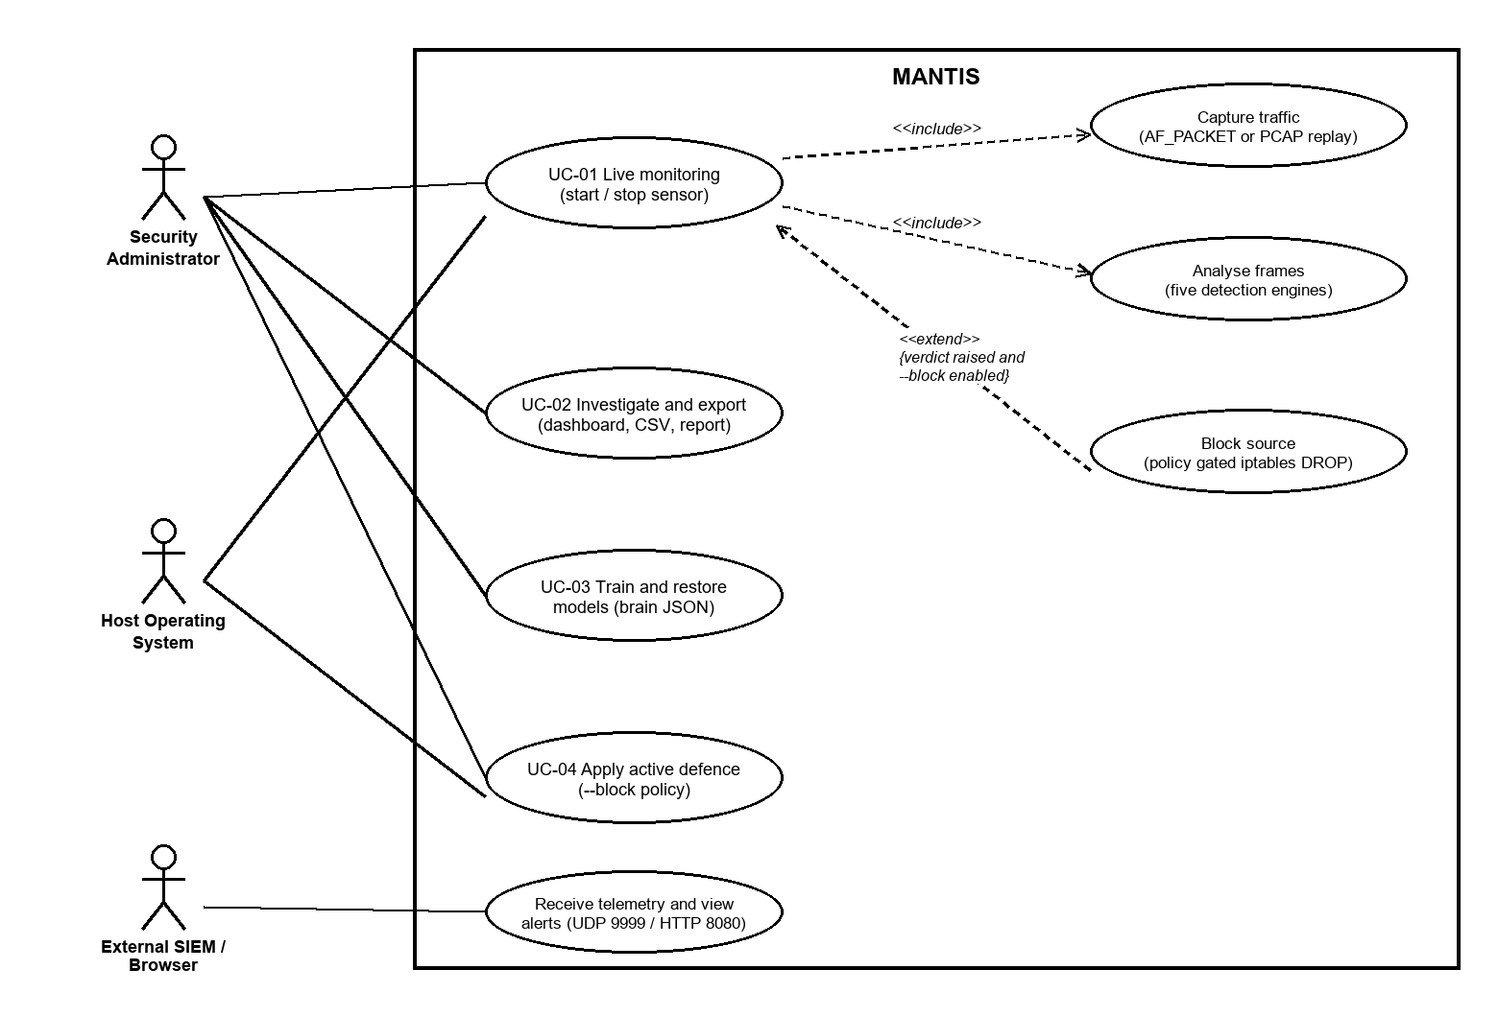
8. Use Case and Response Boundary
Figure 3.1b separates mandatory analysis from optional active defence
9
Notes:
[Sources]
- MANTIS_Final_Dissertation_FINAL.docx, Figure 3.1b and Tables 3.1 to 3.2

Slide 10
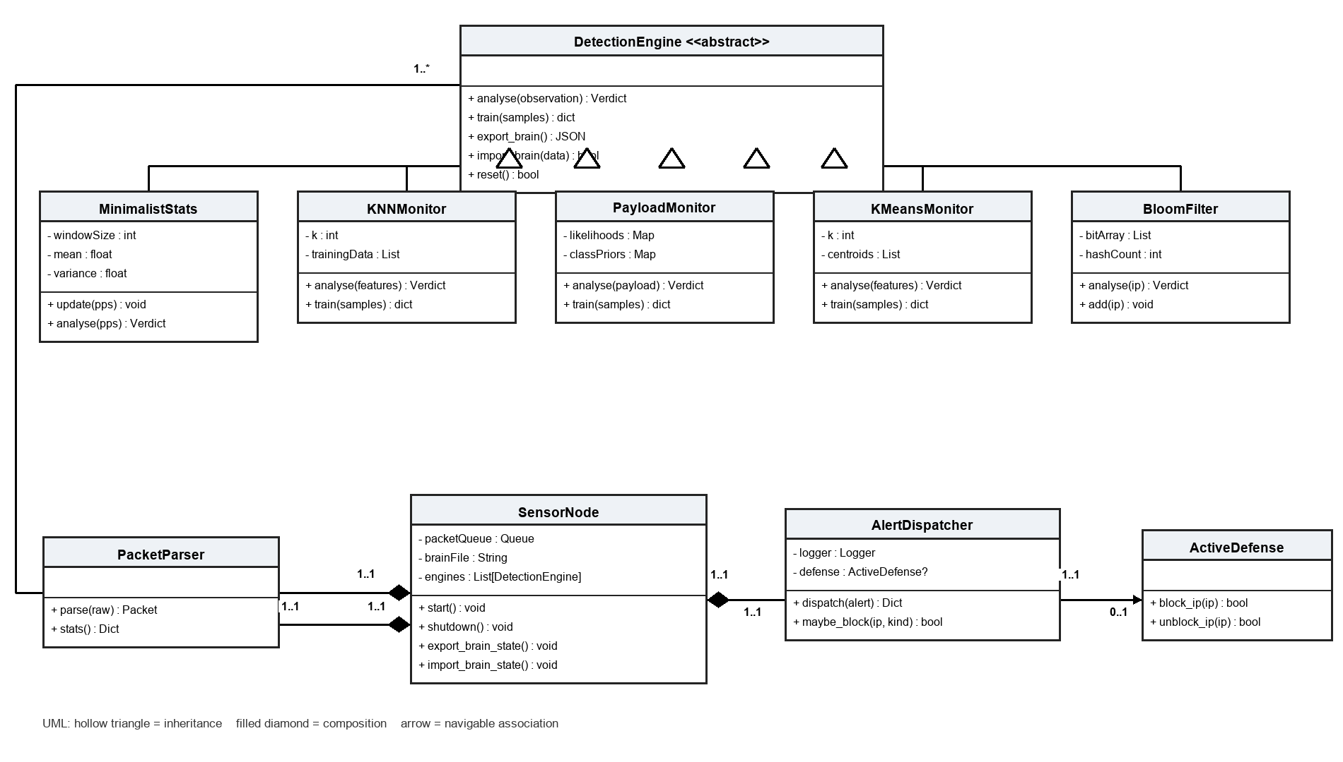
9. Class Model and Component Ownership
Figure 3.3 shows inheritance, composition and explicit multiplicities
10
Notes:
[Sources]
- MANTIS_Final_Dissertation_FINAL.docx, Figure 3.3

Slide 11
10. Five Detection Engines
Each engine targets a distinct behaviour and emits one Verdict contract
Engine | Definition | Detects | System implementation
Z-Score | Deviation from running mean | Flood anomaly | Welford statistics, warm-up, z > 3
KNN | Nearest-neighbour vote | Port scan | Scaled port diversity and packet-count features
Naive Bayes | Token class probability | Malicious payload | Tokenisation with smoothed likelihoods
K-Means | Distance from centroids | Novel behaviour | Online centroids; anomalies do not update the model
Bloom filter | Probabilistic membership | Known-bad IP | Fixed bit array and multiple hashes from a feed
• Detection remains separate from alerting and firewall policy.
11
Notes:
[Sources]
- MANTIS_Final_Dissertation_FINAL.docx, Sections 2.9 and 3.6

Slide 12
11. System Build
A dependency-free implementation with explicit technical and safety boundaries
• Python 3 standard library only, including socket, struct, threading, JSON, HTTP server and unittest.
• Packet capture uses AF_PACKET raw sockets, so Linux and suitable capability or privilege are required.
• Parser checks Ethernet, tagged VLAN, IPv4, TCP, UDP and ICMP bounds before engine use.
• SIEM delivery uses UDP JSON; the browser dashboard is served locally on port 8080.
• Engine state is versioned JSON and shutdown reports preserve evidence for review.
12
Notes:
[Sources]
- MANTIS_Final_Dissertation_FINAL.docx, Chapter 4 and Table 4.1

Slide 13
12. Testing Strategy
Verify software behaviour first, then evaluate detection transfer
• White-box tests checked engine mathematics, parser bounds, risk mapping, redaction and persistence.
• Integration tests covered parser-to-engine flow, dispatcher fan-out, state round trips and duplicate suppression.
• Black-box tests exercised CLI, UDP and HTTP endpoints, filtering, malformed datagrams and PCAP export.
• All 116 automated tests passed on 20 August 2026 in 4.642 seconds.
• Twenty-eight representative cases record expected and actual outcomes with terminal evidence.
13
Notes:
[Sources]
- MANTIS_Final_Dissertation_FINAL.docx, Chapter 5 and Tables 5.1, 5.3 and 5.4

Slide 14
13. Controlled Checks
Small engine-specific samples verify code paths, not deployment accuracy
Engine | N | Scenario | Outcome | Limit | Meaning
KNN | 40 | Port scan | Matched | Small set | Path check
Naive Bayes | 24 | Payload | Recall .9167 | 1 miss | Metric check
Z-Score | 40 | Flood | Matched | Constructed | Path check
K-Means | 44 | Novelty | Matched | Small vectors | Path check
Bloom | 25 | Bad IP | Inserted found | Property only | Set check
• Perfect values on matched constructed sets are implementation evidence, not generalisation evidence.
• The obfuscated Naive Bayes miss is retained and reported rather than tuned away.
14
Notes:
[Sources]
- MANTIS_Final_Dissertation_FINAL.docx, controlled engine checks in Chapter 5

Slide 15
14. External Dataset Evaluation
CIC-IoT2023: 63 files, 45,018,252 rows and 9.30 GB
Evaluation scope | Rows | Precision | Recall | F1 | MCC
All merged files | 45,018,252 | .997417 | .043619 | .083582 | .029049
Benign + DoS/DDoS | 41,333,350 | .997302 | .045574 | .087165 | .031179
Always-positive baseline | 45,018,252 | .976647 | 1.000000 | .988186 | 0.000000
Missed attack rows | 42,049,152 |  | 95.64% missed
Compatible feature | Rate only
• Only Rate matched the external files, so this is a Z-Score transfer stress test, not a five-engine benchmark.
• High precision concealed very low recall; the fixed three-sigma rule did not transfer to heavy-tailed flow data.
15
Notes:
[Sources]
- MANTIS_Final_Dissertation_FINAL.docx, Table 5.2 and the external CIC-IoT2023 evaluation discussion

Slide 16
15. Conclusion and Next Steps
• MANTIS meets its aim as an inspectable lightweight research prototype with five integrated detection engines.
• Evidence includes 116 passing tests, 28 traced cases and a 45-million-row external stress test.
• Correct software behaviour does not guarantee field accuracy without calibration and domain-matched temporal data.
• Next steps are encrypted-traffic feature sources, authenticated SIEM delivery, longer-window evaluation and model lifecycle controls.
• MANTIS is a transparent baseline for constrained hosts and teaching, not an enterprise IDS replacement.
Transparent implementation, honest evidence, clear next steps
16
Notes:
[Sources]
- MANTIS_Final_Dissertation_FINAL.docx, Chapters 6 and 7

